Slide 1





Malpractice Detection in classroom Exam
lokesh chandra
CB.EN.U4CSE21211
Deepak Kumar
CB.EN.U4CSE2129
Sasidhar
CB.EN.U4CSE21256
Ram Darshan Reddy
CB.EN.U4CSE21269

Slide 2
MOTIVE
Implementing a system to catch cheating during exams in classrooms is really important to keep our schools honest and make sure everyone is evaluated fairly. This project goes beyond just maintaining academic standards. It encourages a culture where students are honest and work hard, making things easier for teachers and using new technology to spot cheating.
In the end, this kind of project not only makes schools more trustworthy and competitive but also creates an environment where learning is valued, and everyone gets a fair shot at growing as a student.
It also helps students grow by promoting good behavior, boosts the school's reputation, follows the rules, and gives useful insights from data to make better decisions.

Slide 3
Challenges
Diverse Cheating Methods:
Detecting various cheating methods such as copying, unauthorized materials, and electronic device usage requires comprehensive monitoring strategies.
Variable Exam Settings:
Exam rooms may have different lighting, seating arrangements, and camera angles, posing challenges in capturing consistent and clear images for analysis.
Real-Time Detection Efficiency:
Conducting real-time detection demands fast algorithms capable of analyzing data swiftly to provide timely alerts without causing disruptions.
Disguised Cheating Attempts:
Students may attempt to disguise cheating behaviors to evade detection, requiring detection systems to be highly sensitive and discerning.
Privacy and Ethical Concerns:
Balancing the need for monitoring with privacy rights and ethical considerations demands careful implementation and adherence to legal regulations regarding surveillance and student privacy.

Slide 4

Problem Statement:
The project involves dealing with images or videos from classroom exams and has two main objectives:
a. Create a smart system that can spot instances of cheating during exams. This system should be strong enough to handle different challenges like people using tricks to cheat, background noise, and any technological tools they might use.
b. Make an algorithm that not only finds cheating but also figures out how serious it is. This means understanding where the cheating is happening, in which direction it's spreading, and how big of an area is affected. The goal is to have a complete solution that can alert the right people and prevent any potential problems during exams in schools.

Slide 5
Data Set
You'll need a dataset consisting of images or videos of exam settings or scenarios where malpractice might occur. This could include images or videos of classrooms, exam halls, or students taking exams.
For labeled data, you'll need annotations indicating instances of malpractice (e.g., cheating, using unauthorized materials, copying from others).
Additionally, you might need context information such as time stamps, exam types, or specific exam conditions.

Slide 6
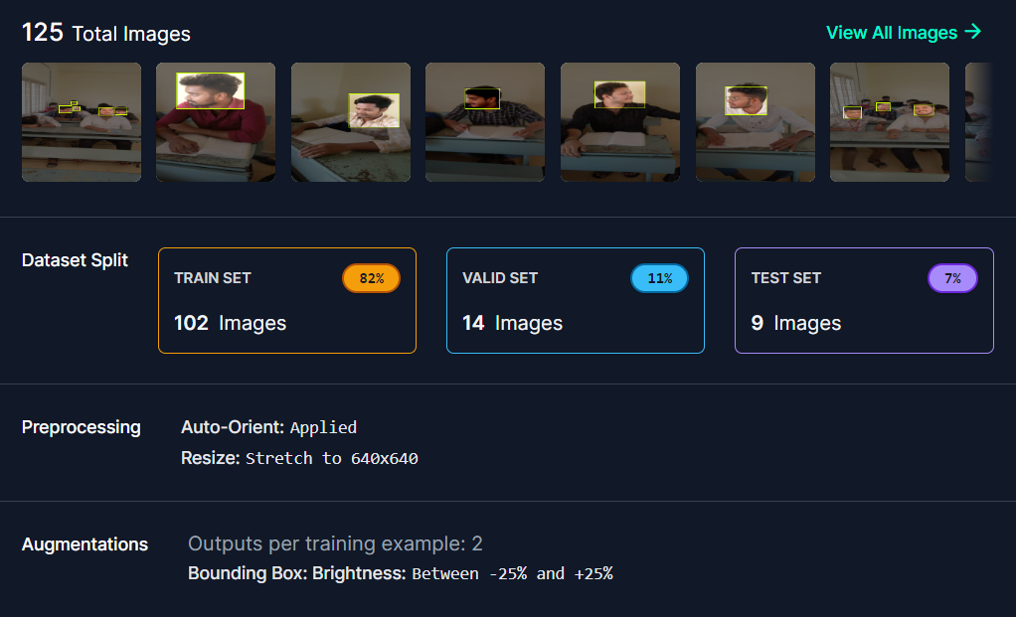
Data Set

Slide 7
Data Set
The dataset for malpractice detection in exams would typically include the following components:
Zoomed-in images: The primary data source would be zoomed-in images captured during exam sessions. These images would focus on specific areas of interest, such as individual students' desks, groups of students, or areas where malpractice is suspected. These zoomed-in images could be obtained from surveillance cameras or other recording devices set up in the examination hall or rooms.
No annotations or labels: In this case, the dataset would not include any manual annotations or labels indicating instances of malpractice. The images themselves would be the sole source of data, and the task would be to identify potential malpractice scenarios from the zoomed-in visual information alone.

Slide 8
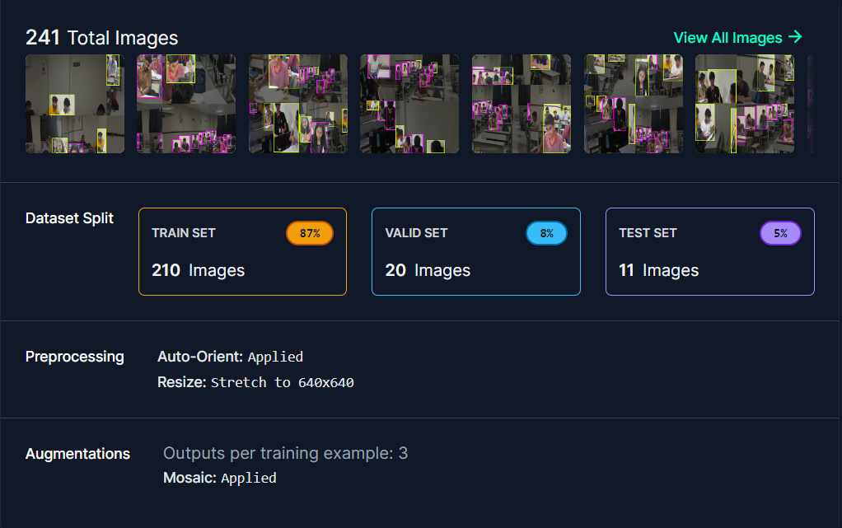
Data Set

Slide 9
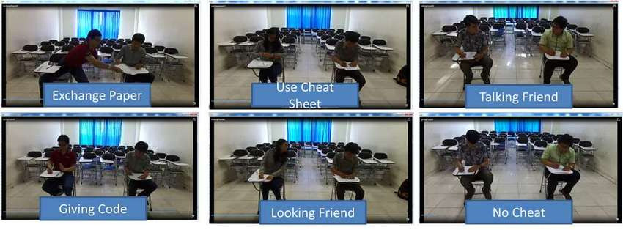

Slide 10
Detection
Features:
Features are distinctive characteristics or patterns in an image that can be used for various computer vision tasks such as object recognition, image matching, and malpractice detection in exams.
Features can include edges, corners, blobs, or regions with unique textures or colors that stand out from the background.

Slide 11
Detection
Algorithms for Feature Detection:
Harris Corner Detection: Identifies corners in an image by analyzing variations in intensity.
SIFT (Scale-Invariant Feature Transform): Detects and describes local features that are invariant to scale, rotation, and illumination changes.
SURF (Speeded-Up Robust Features): Similar to SIFT but computationally faster, making it suitable for real-time applications.
ORB (Oriented FAST and Rotated BRIEF): A fusion of FAST keypoint detector and BRIEF descriptor, offering a good balance between speed and accuracy.

Slide 12
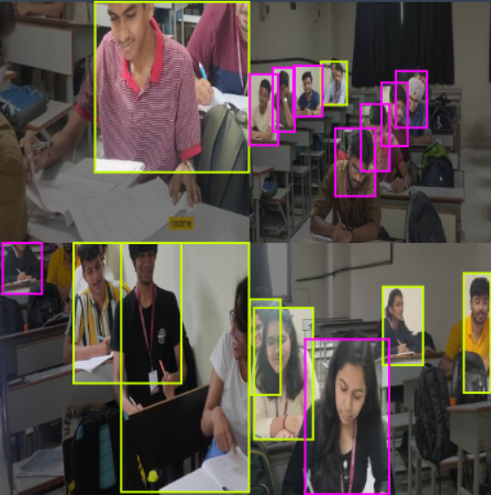
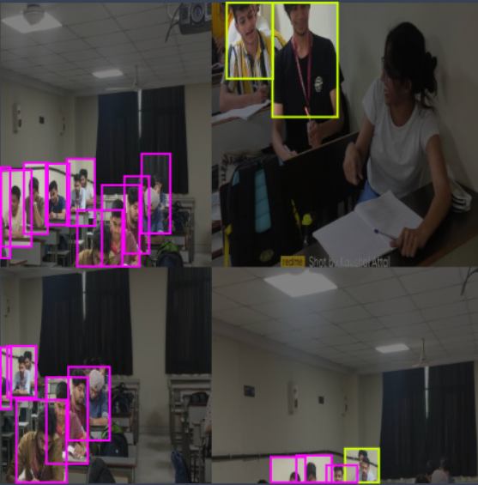
Detection

Slide 13
Detection
Data Type of Features:
Features are typically represented as data structures containing information about their location, scale, orientation, and descriptor.
Common data types for features include keypoints (e.g., (x, y) coordinates), descriptors (e.g., histograms of gradients or pixel intensities), and auxiliary information like scale and orientation.

Slide 14
Detection
Point to Vector Conversion:
In computer vision, points detected as features are often converted into feature vectors for further processing and analysis.
Feature vectors represent the feature's characteristics numerically, facilitating tasks such as matching, classification, and clustering.
The conversion process involves extracting relevant information from the detected points, such as their descriptors and auxiliary attributes, and organizing them into a structured numerical format.

Slide 15
Detection
Correlation to Computer Vision Approach:
Feature detection and description are fundamental steps in various computer vision approaches, including object recognition, image stitching, and malpractice detection in exams.
Once features are detected and represented as vectors, they can be matched between images to identify corresponding points, enabling tasks such as image alignment and object tracking.
In the context of malpractice detection in exams, features can be used to detect suspicious patterns or anomalies in students' behavior, such as unauthorized materials or electronic device usage, by analyzing the features extracted from exam monitoring footage.

Slide 16
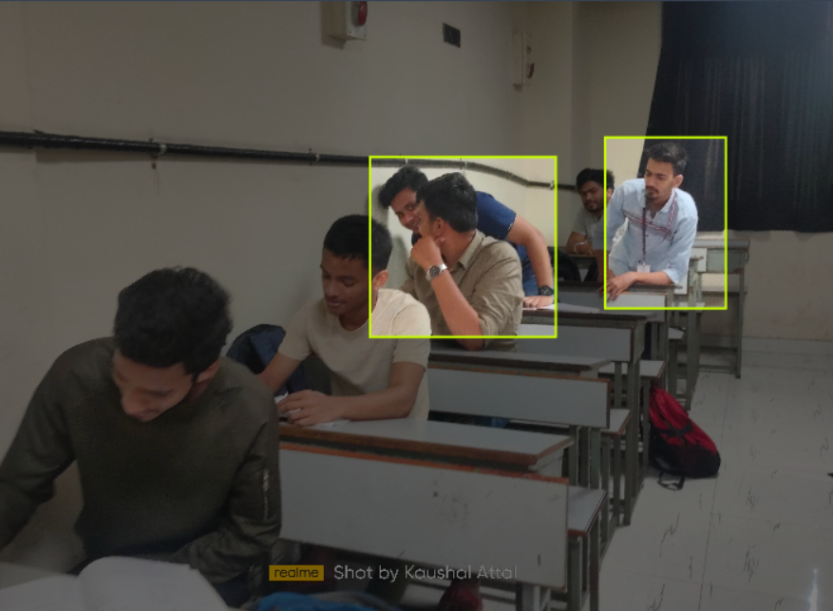
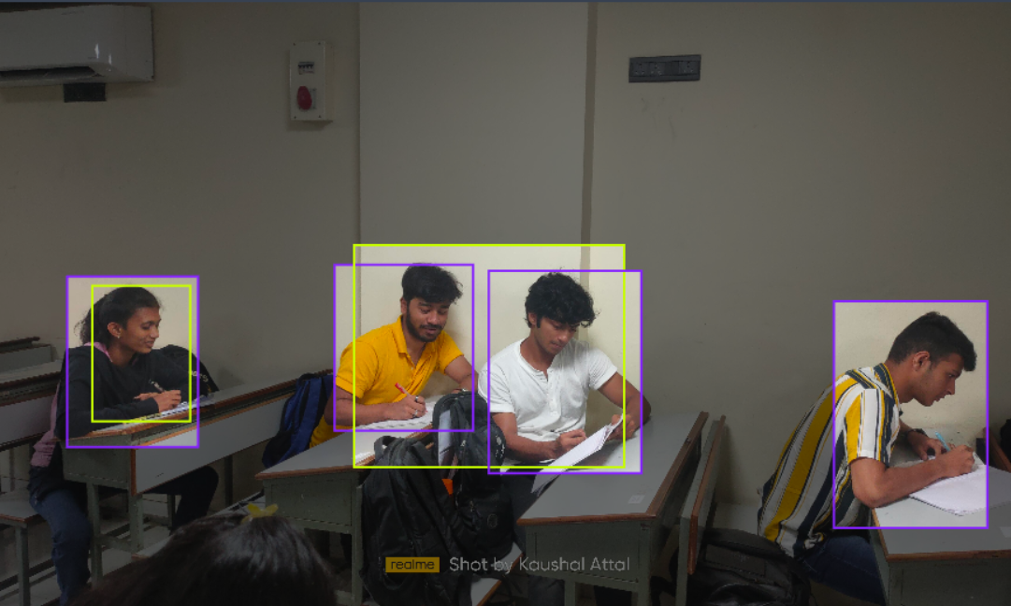
Tracking

Slide 17
Tracking
In a project aimed at malpractice detection in exam classrooms using computer vision, incorporating tracking algorithms like Snake and Optical Flow can enhance the system's ability to monitor and analyze student behaviors. Here's an overview of each:
1.Snake (Active Contour) Algorithm:
Definition: The Snake algorithm, also known as active contour model or deformable model, is used for contour detection and tracking in images. It's particularly useful for identifying and tracking non-rigid objects or boundaries.

Slide 18
Tracking
Functionality: The algorithm works by iteratively deforming a contour or curve to match the edges or features of an object in an image. It seeks to minimize an energy function that consists of both internal forces (smoothness) and external forces (attraction to image features).
Application: In the context of malpractice detection, Snake algorithms can be utilized to track the movement of objects such as hands or eyes, which may indicate suspicious behavior during an exam. For example, it can track the movement of a hand reaching for unauthorized materials or electronic devices.

Slide 19
Tracking
2.Optical Flow Algorithm:
Definition: Optical flow is a computer vision technique used to estimate the motion of objects between consecutive frames in a video sequence. It calculates the displacement of pixels between frames to infer the movement of objects.
Functionality: Optical flow algorithms analyze the spatial and temporal changes in pixel intensities to compute the motion vectors of objects in an image sequence. These motion vectors represent the direction and magnitude of object movement.

Slide 20
Tracking
Application: In the exam malpractice detection project, Optical Flow can be employed to track the movement of students within the exam room. It can detect sudden movements, deviations from normal behavior patterns, or unauthorized actions such as looking at neighboring papers or using electronic devices.
By integrating these tracking algorithms into the computer vision system, it becomes possible to monitor and analyze student activities in real-time during exams more effectively. These algorithms provide valuable insights into object movement and behavior patterns, enabling the detection of suspicious activities that may indicate cheating or malpractice.

Slide 21
Matching
Image Enhancement Filters:
Gaussian Blur: Smoothens the image by reducing high-frequency noise and details, making it suitable for preprocessing before feature extraction or matching.
Median Filtering: Removes salt-and-pepper noise by replacing each pixel's value with the median value of its neighborhood, improving image quality for subsequent processing steps.
Contrast Enhancement: Techniques such as histogram equalization or adaptive histogram equalization can enhance image contrast, making features more distinguishable.
Edge Enhancement: Filters like the Sobel operator or Laplacian of Gaussian (LoG) can accentuate edges in an image, aiding in feature extraction and matching.

Slide 22
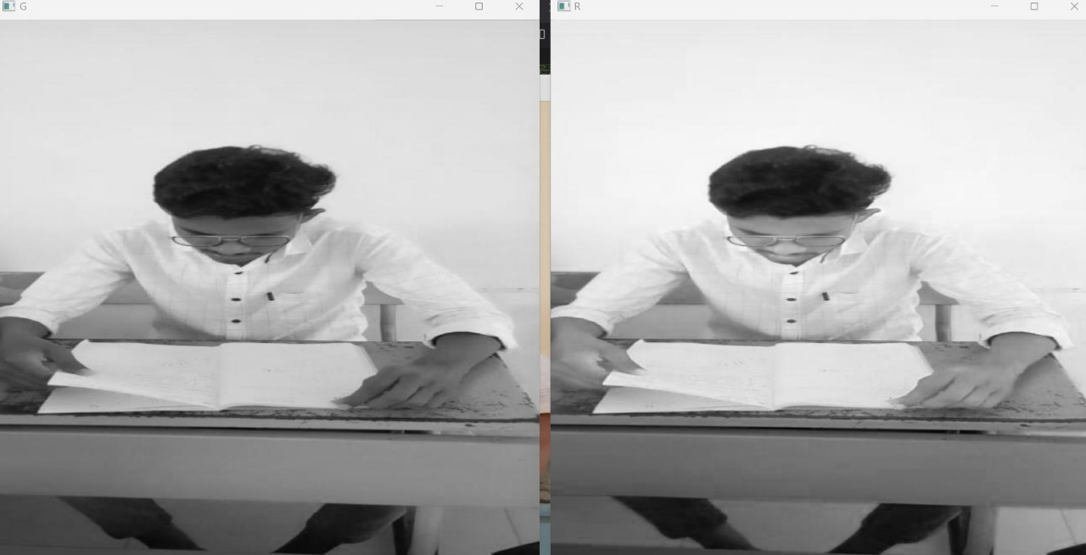
Matching

Slide 23
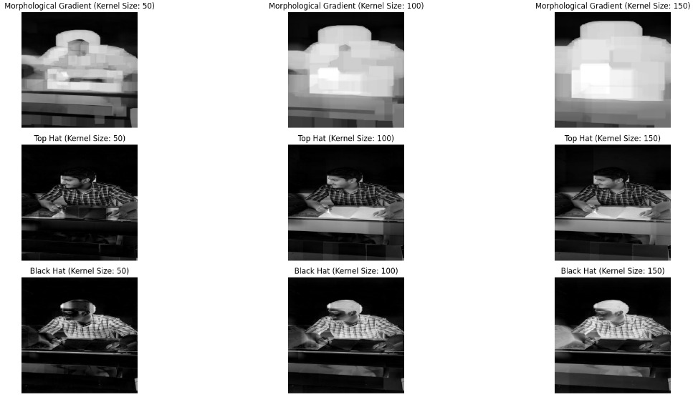
Matching

Slide 24
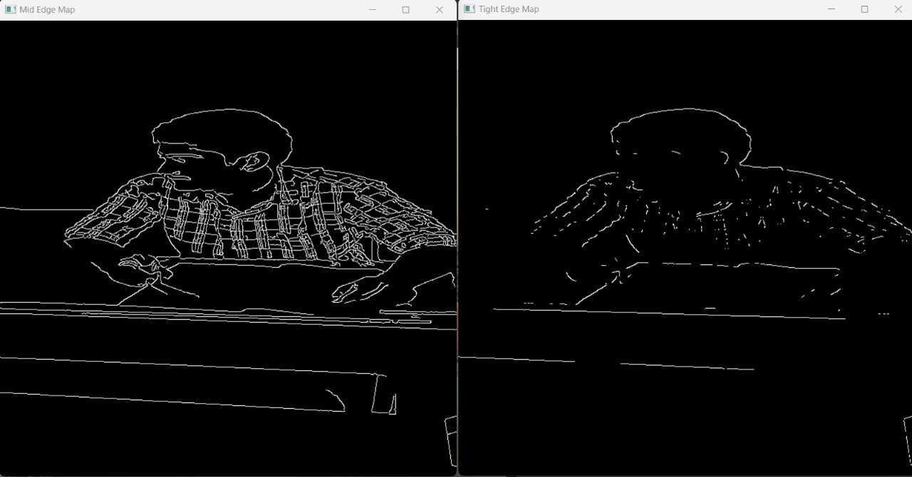
Matching

Slide 25
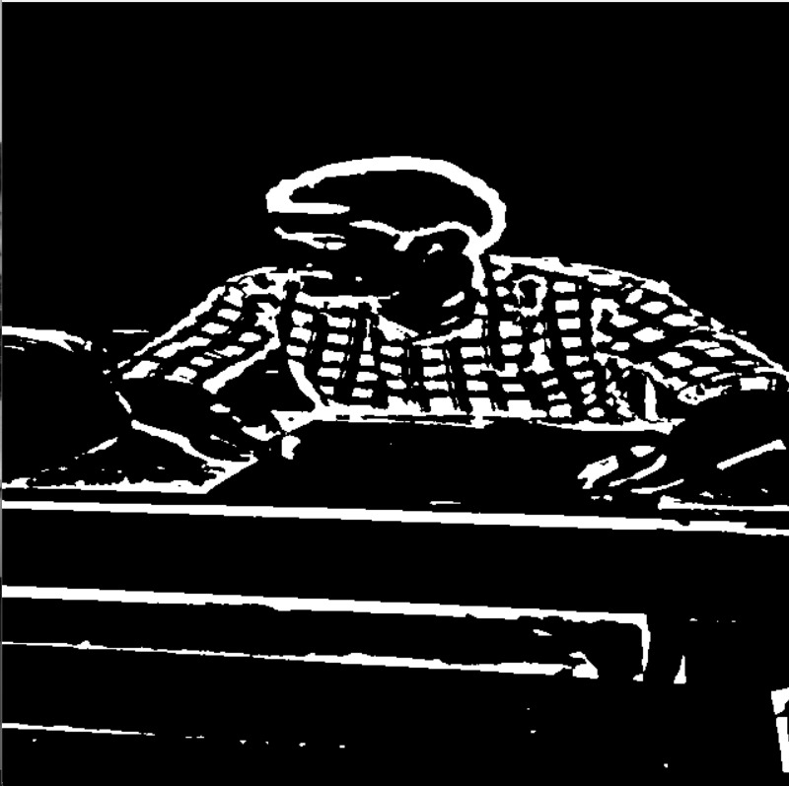
Matching

Slide 26
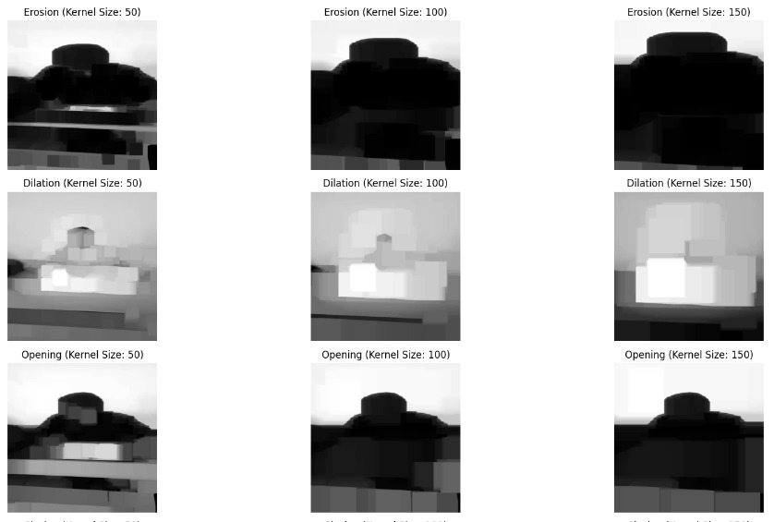
Matching

Slide 27
Matching
Color Models:
RGB (Red, Green, Blue): Commonly used for its simplicity, representing colors using combinations of red, green, and blue channels.
HSV (Hue, Saturation, Value): Separates color information into hue, saturation, and value components, making it useful for color-based segmentation and feature extraction.
Lab (CIELAB): Based on human perception, Lab color space separates luminance (L) from chromaticity components (a and b), providing perceptually uniform color representations.
YCbCr: Separates luminance (Y) from chrominance (Cb and Cr), facilitating compression and transmission while preserving image quality.

Slide 28
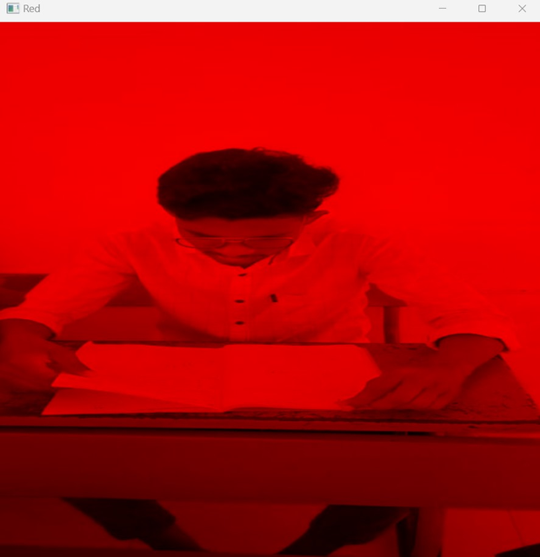
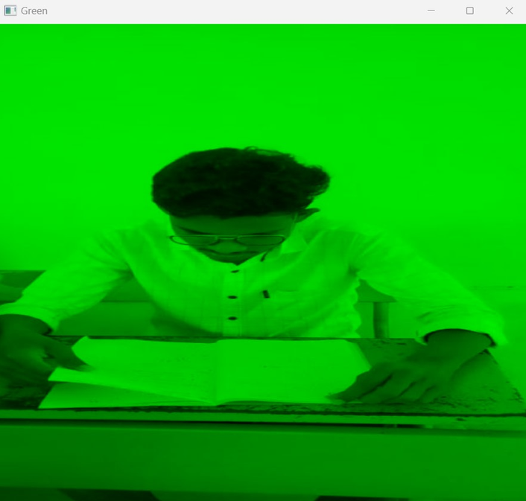
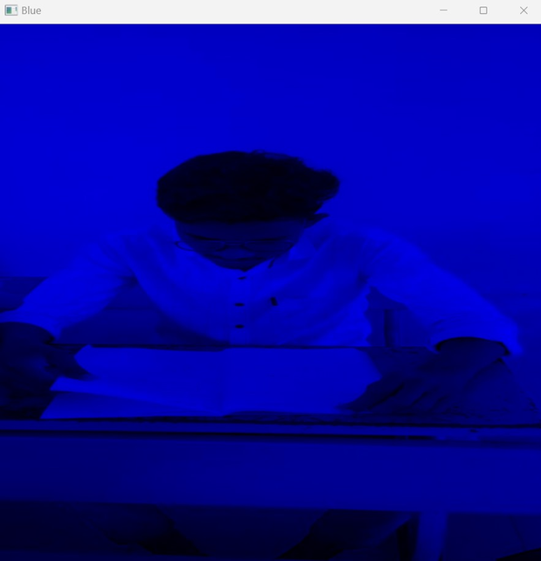
Matching

Slide 29
Matching
Keyframe Extraction Approaches:
Shot Boundary Detection: Detects significant changes between consecutive frames, such as cuts, fades, or scene transitions, indicating potential keyframes.
Clustering-Based Methods: Cluster frames based on visual similarity using techniques like K-means clustering, hierarchical clustering, or DBSCAN (Density-Based Spatial Clustering of Applications with Noise).
Salient Feature Detection: Identifies frames with salient or significant visual content using algorithms like SIFT (Scale-Invariant Feature Transform) keypoints or SURF (Speeded-Up Robust Features).

Slide 30
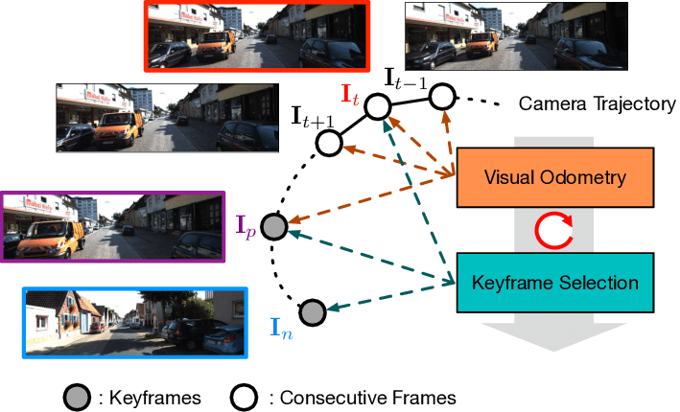
Matching

Slide 31
Matching
Image denoising is a crucial task in modern image processing systems. It involves reducing noise in images without losing important image features such as edges, corners, and other sharp structures. Noise can be introduced during image acquisition, compression, and transmission, leading to distorted and degraded visual image quality. The presence of noise can adversely affect subsequent image processing tasks like video processing, image analysis, and tracking.
The demand for accurate and visually pleasing images is increasing with the proliferation of digital cameras. However, images captured by modern cameras are inevitably degraded by noise, which affects the overall image quality. Therefore, it is necessary to develop techniques that can effectively reduce noise while preserving image features.

Slide 32
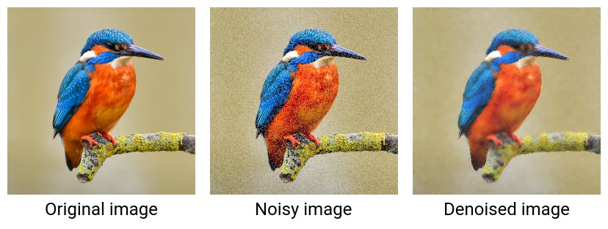
Matching

Slide 33
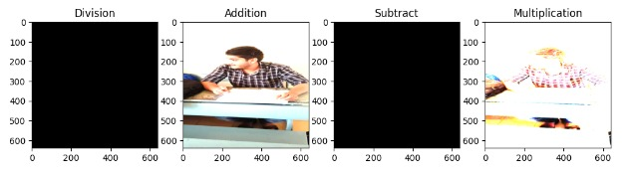
Matching

Slide 34
Matching
Computer Vision Algorithms for Keyframes:
SIFT (Scale-Invariant Feature Transform): Extracts distinctive keypoints and descriptors from images, which can be used for keyframe selection based on feature density or uniqueness.
SURF (Speeded-Up Robust Features): Similar to SIFT but computationally faster, suitable for real-time keyframe extraction in video sequences.
Optical Flow: Estimates motion between frames, identifying keyframes based on significant changes in motion or scene dynamics.
CNN-Based Methods: Convolutional neural networks (CNNs) trained for keyframe selection or saliency prediction can automate the process of identifying important frames in videos.

Slide 35
Matching
Handling Keyframe Noise:
Temporal Smoothing: Applying temporal smoothing techniques like median filtering or Gaussian filtering can reduce noise in keyframe sequences.
Thresholding: Setting appropriate thresholds during keyframe extraction based on visual content similarity or motion characteristics can filter out noisy or irrelevant frames.
Quality Assessment: Incorporating quality assessment metrics such as sharpness, contrast, or entropy can help identify and discard noisy keyframes.

Slide 36
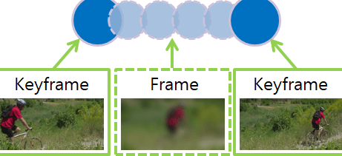
Matching

Slide 37
Overview:
Objective:Develop a robust face detection algorithm for real-time video surveillance in a classroom examination setting.
Approach:Utilize Haar cascades for foreground object extraction and face region detection in preprocessed surveillance videos.
Activity Classification:Implement an activity classification system to distinguish between normal and suspicious behavior.Consider factors like face orientation, hand contact detection using background subtraction, and Gaussian mixture model (GMM).
Suspicious Activities Detected:Identify and address commonly occurring suspicious activities, including object exchange, peeping into others' answer sheets, and people exchanging materials during examinations.
Automation Benefits:Aim to reduce the error rate associated with manual monitoring by automating the detection of suspicious activities.
Results:Present promising outcomes, showcasing significant improvements, especially in scenarios involving challenges such as varying illumination and diverse face orientations.
Significance:Contribute to enhancing examination security and integrity by providing an automated system capable of identifying and addressing malpractices effectively.
Innovation:Introduce a comprehensive approach that combines face detection, activity classification, and automated suspicious activity detection to offer a more reliable solution compared to existing methods.
Challenges Addressed:Tackle issues related to illumination and orientation, ensuring the algorithm's effectiveness in diverse classroom conditions.
Potential Impact:The proposed system has the potential to significantly improve the efficiency of examination monitoring and decrease the reliance on manual oversight, thereby enhancing the integrity of the education system.

Slide 38
Plan:
Data Collection: Assemble a diverse dataset for robust algorithm training.
Preprocessing: Clean and prepare data, addressing noise and variations.
Algorithm Development: Create an effective malpractice detection algorithm for diverse scenarios.
Testing and Validation: Evaluate algorithm performance for accuracy and reliability.
Severity Assessment Algorithm: Develop an algorithm for severity assessment, including spread direction and affected area.
Integration and System Testing: Combine algorithms into a cohesive system; conduct thorough testing.
User Interface Design: Design a user-friendly interface for real-time alerts and reports.
Training and Documentation: Provide user training and comprehensive documentation.
Pilot Implementation: Test system in a controlled environment for feedback and refinement.
Refinement and Optimization: Optimize algorithm and system based on feedback.
Scale-up Deployment: Deploy system on a larger scale, incorporating lessons learned.
Continuous Improvement: Establish a feedback loop for ongoing enhancements and adaptability.

Slide 39


